Slide 1
E-SOIL
10/31/2016
GitHub Link:
https://github.com/wudi-bu/NASA-Africa
Trello Link:
https://trello.com/b/kfhX7kJh/nasa-africa-sprint-2
Notes:
1

Slide 2
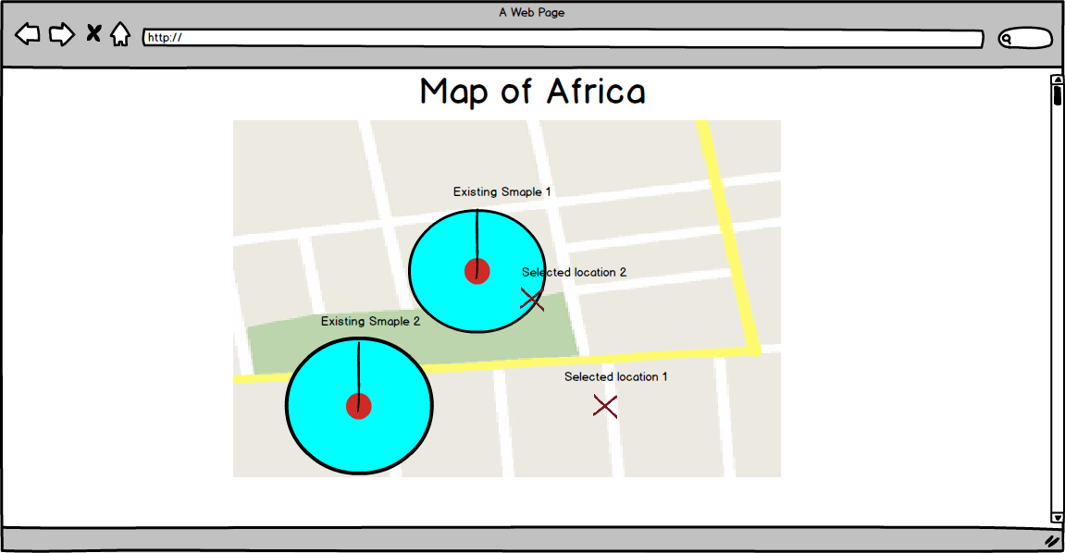
Product Reminder

Slide 3
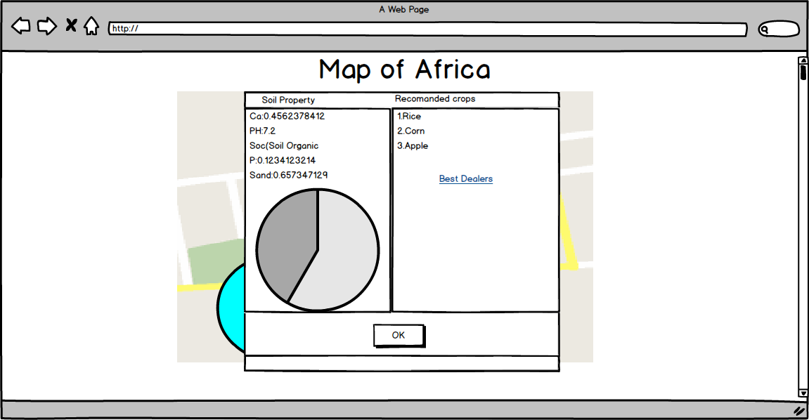
Product Reminder

Slide 4

Name Change
10/10/16
NASA/Africa →Doors→E-SOIL

Slide 5



Contents
10/10/16
Accomplishments for Sprint 2
Changes
Challenges
Sprint 3 plan

Slide 6
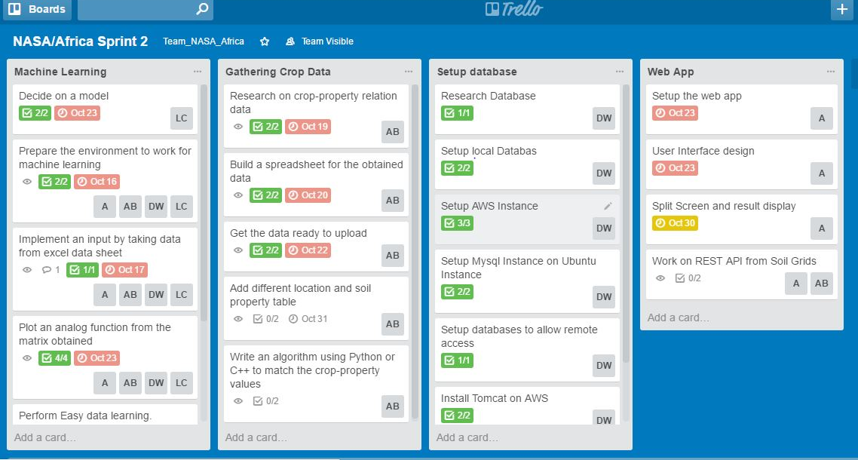
Trello Sprint 2 Diagram
*
6

Slide 7
Accomplishments
*
Setup EC2 instance in Ubuntu
Setup MySQL on EC2 and configured remote access
Created data tables based on soil property relation to crop
Integrated Google Maps API on Website
Setup Tomcat on EC2 and deployed version 1.0 war
file
Established a preliminary model with PCA as preprocessing and SVM as learning algorithm
7

Slide 8
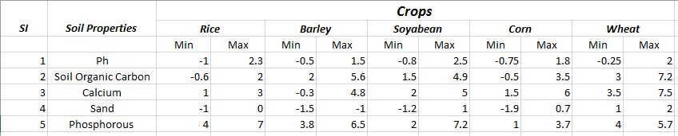
Accomplishments
*
8

Slide 9
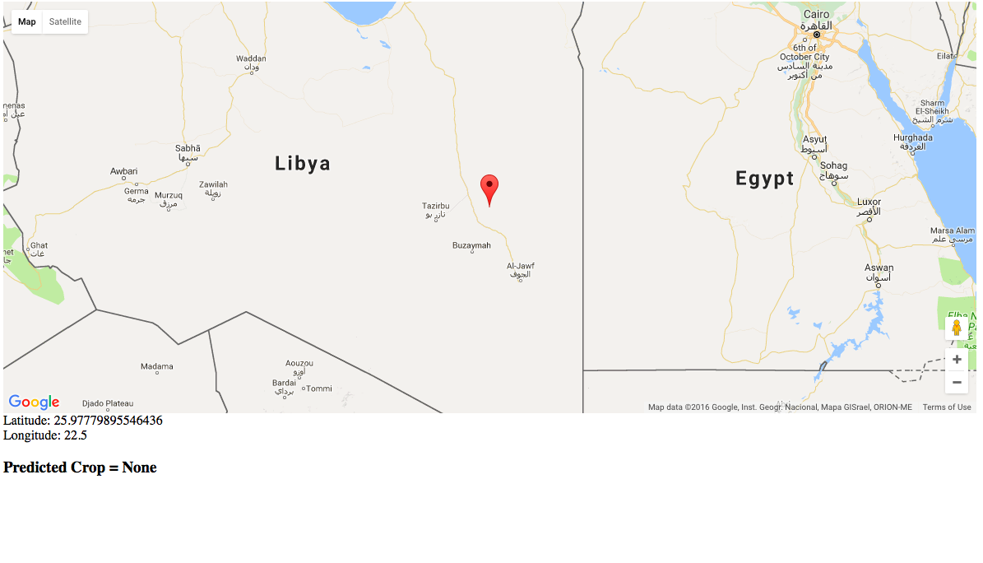
Accomplishments
*
9

Slide 10
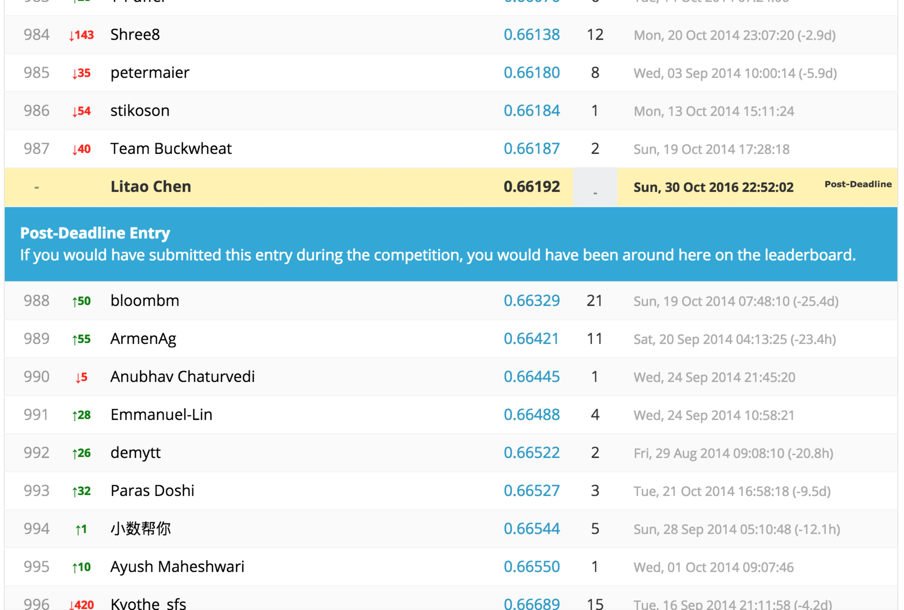
Accomplishments
*
10

Slide 11
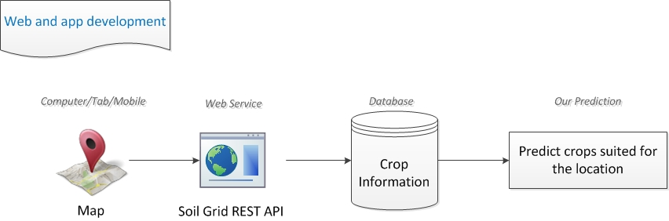
Changes-additional data source
*
11

Slide 12
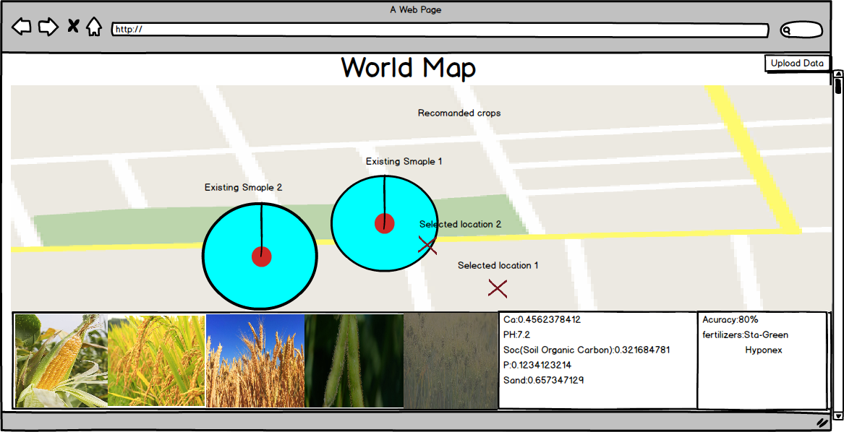
Changes
*
12

Slide 13
Challenges
*
Determining the relation between soil properties and crops
Enhance the accuracy of the data outputs from machine learning algorithms
Map centered and scaled value from spectrum analysis back to real values
Call matlab module within website
13

Slide 14
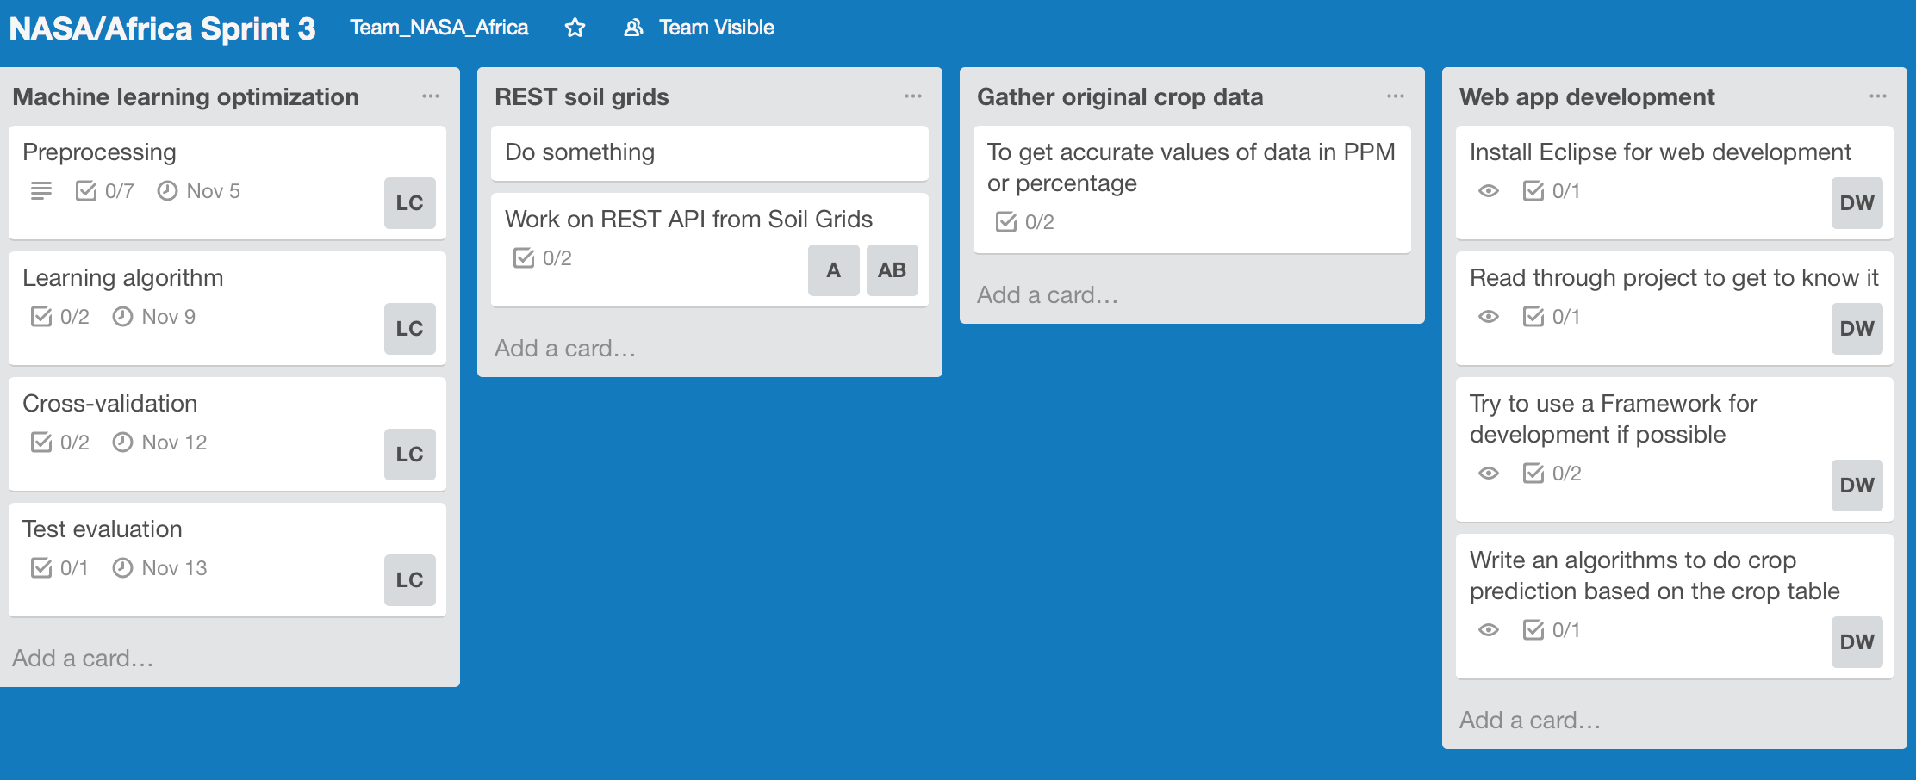
Next Sprint Plan
*
14

Slide 15
THANK YOU
*
15

